Slide 1
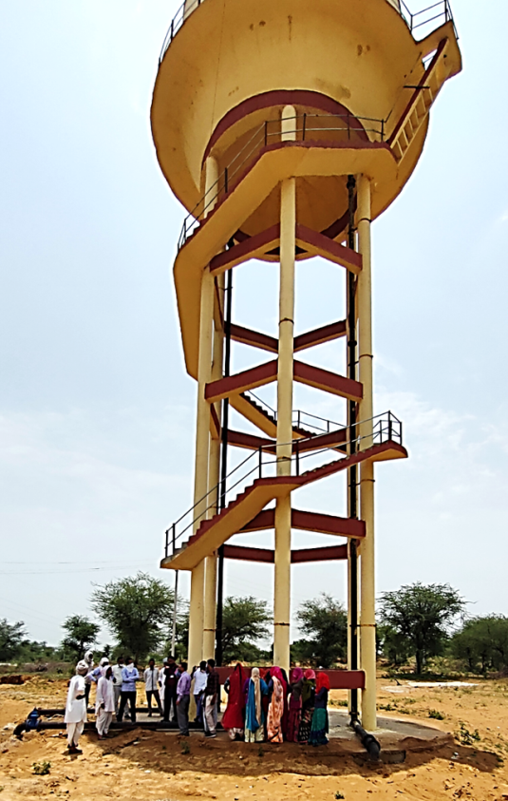



Session-5
Revenue Generation & Sustainability
Presented by:
Dr. SK Srivastava
Director
KRC: Support for Implementation & Research Lucknow

Slide 2
Points we will cover in this session
Revenue Generation
Financial Management as Record Keeping & Community Involvement for Water Supply Management
Sustainability
Marketing Mix and 4P’s
Product Life-Cycle
SWOT Analysis

Slide 3
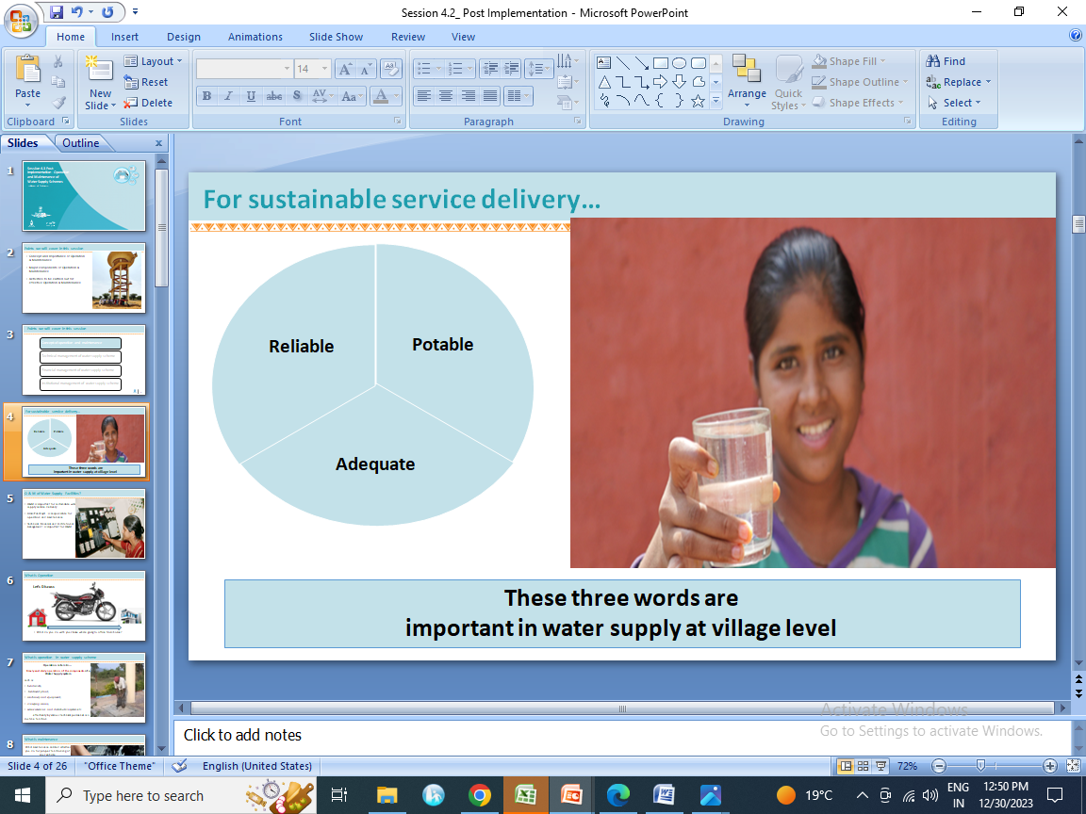

Slide 4
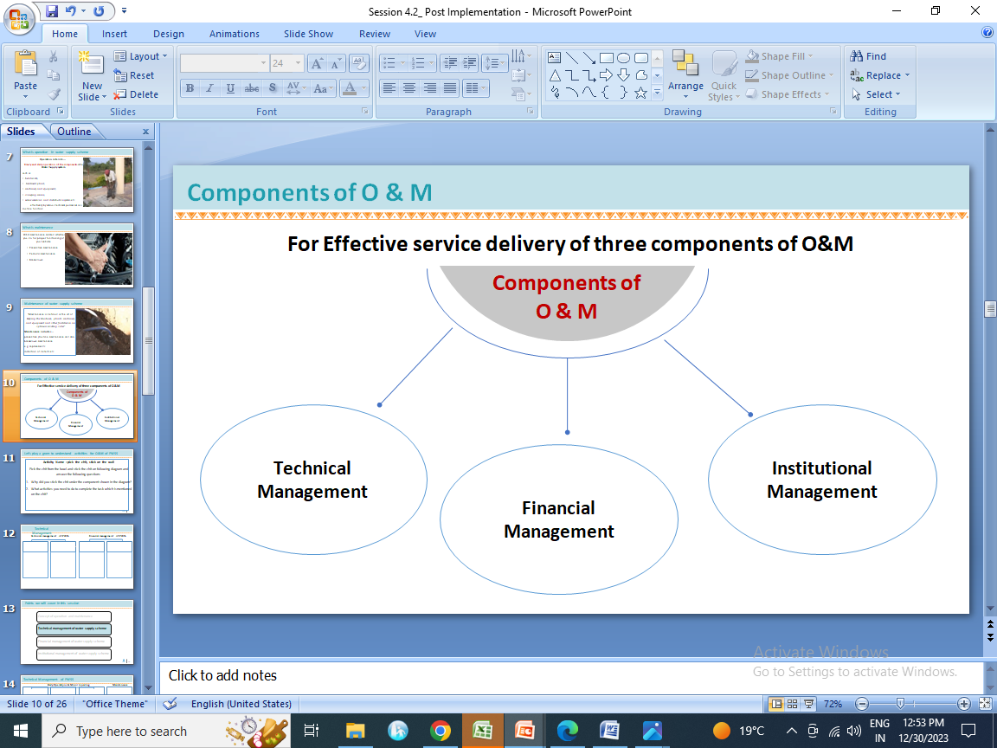

Slide 5
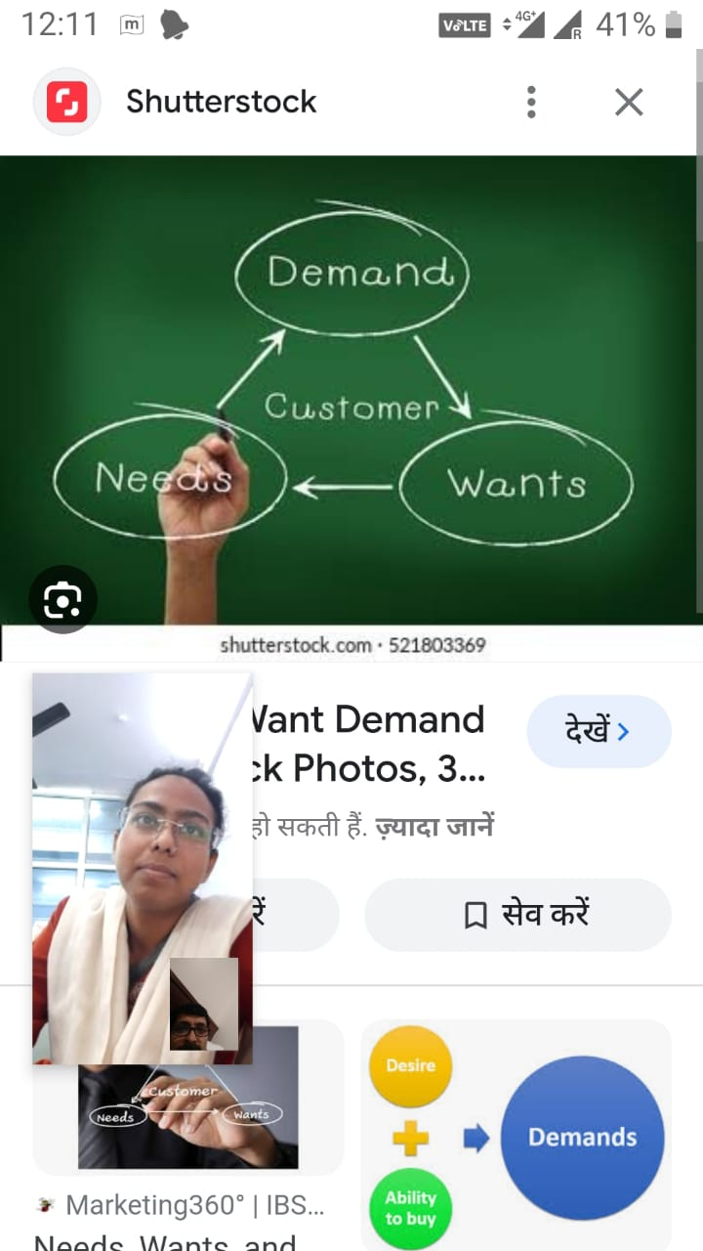

Product/Service
/Consumer

Slide 6
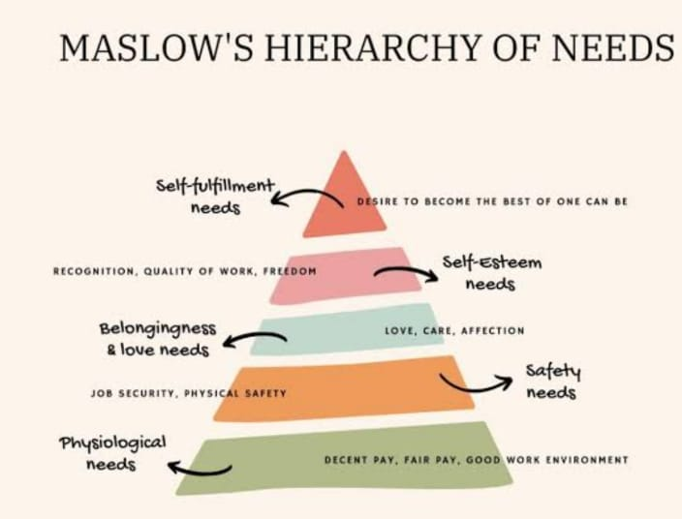

Slide 7
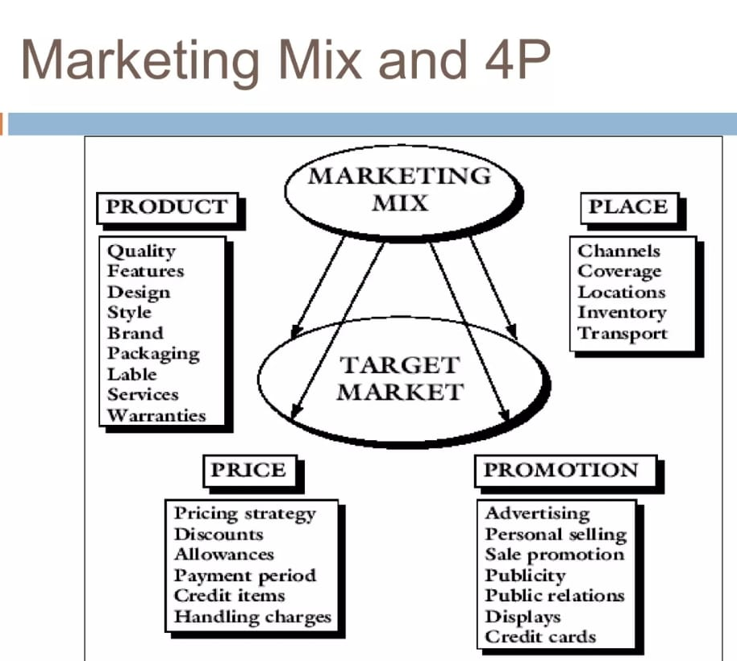

Slide 8
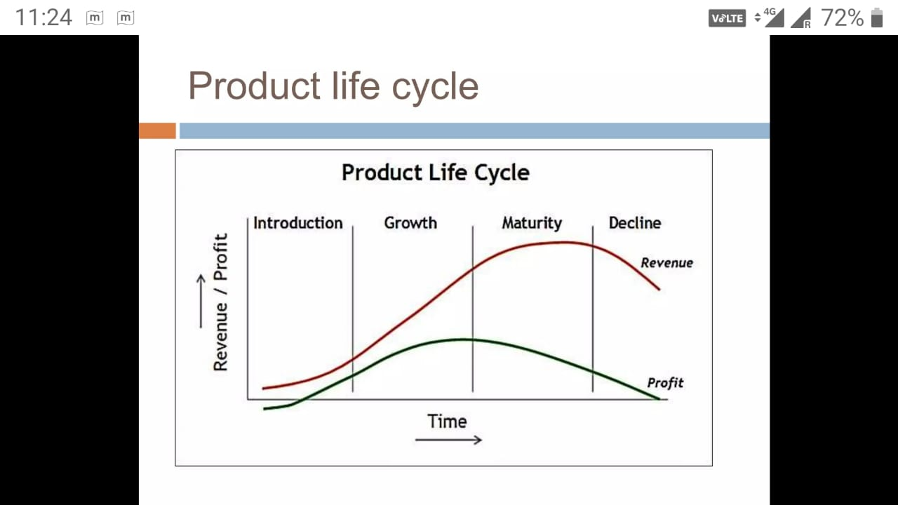

Slide 9
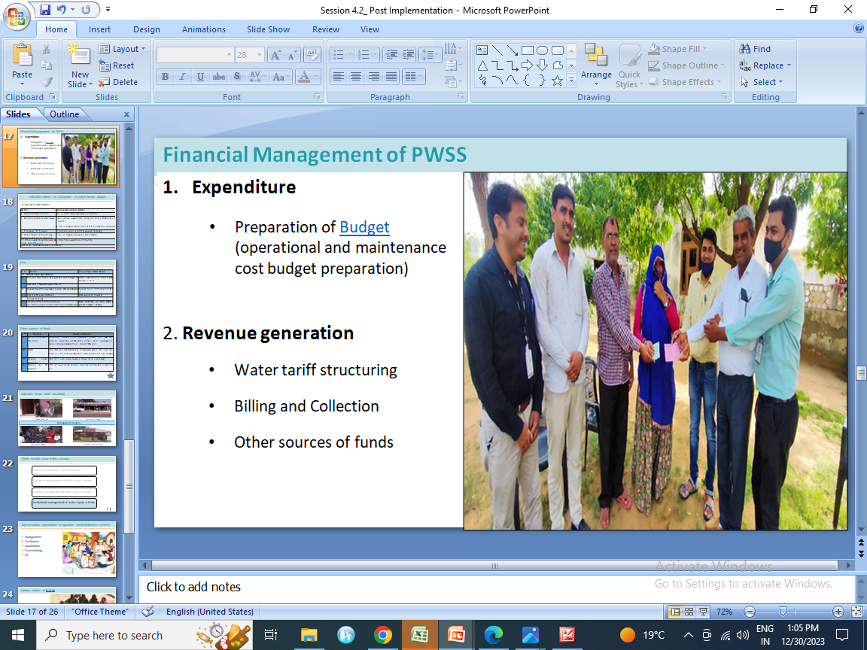
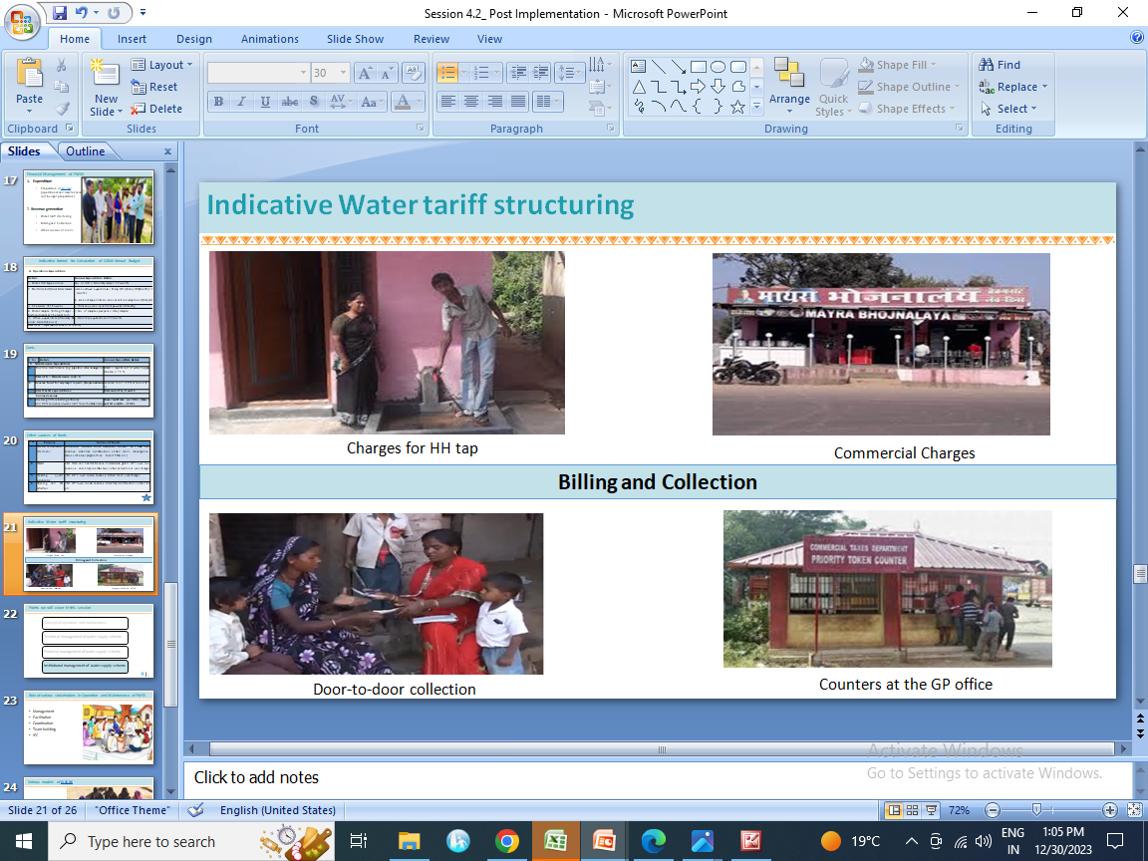

Slide 10
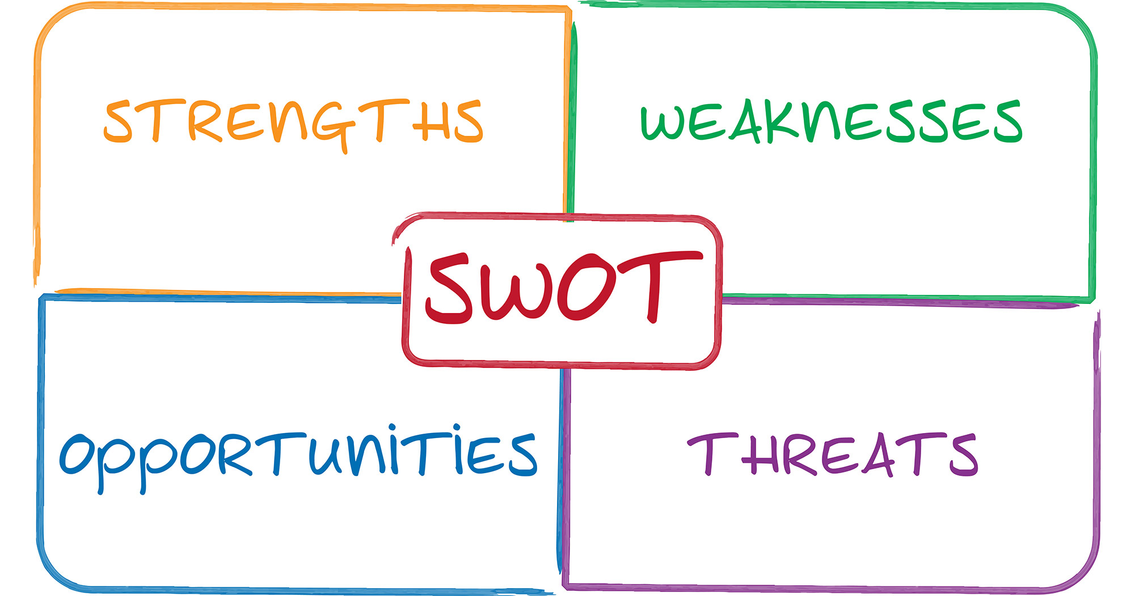

Slide 11
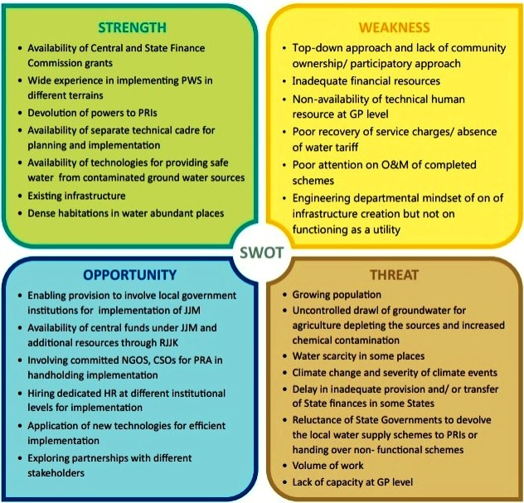
SWOT analysis:
JJM provides an Opportunity to carry out SWOT analysis for better planning and implementation

Slide 12


